Slide 1
Introduction to QuizApp
A Brief Overview of Our Quiz Application
Made by: Jankovics Dávid, Szöllösy Marcell

Slide 2
Requirements, requests from client
Make a quiz in a graphic program about object oriented programing
14 questions
Make it look nice (coloured,not black & white)
Wireframe
Design
The usage of trello, figma and github .
Must be finished before: 2024/03/28.

Slide 3
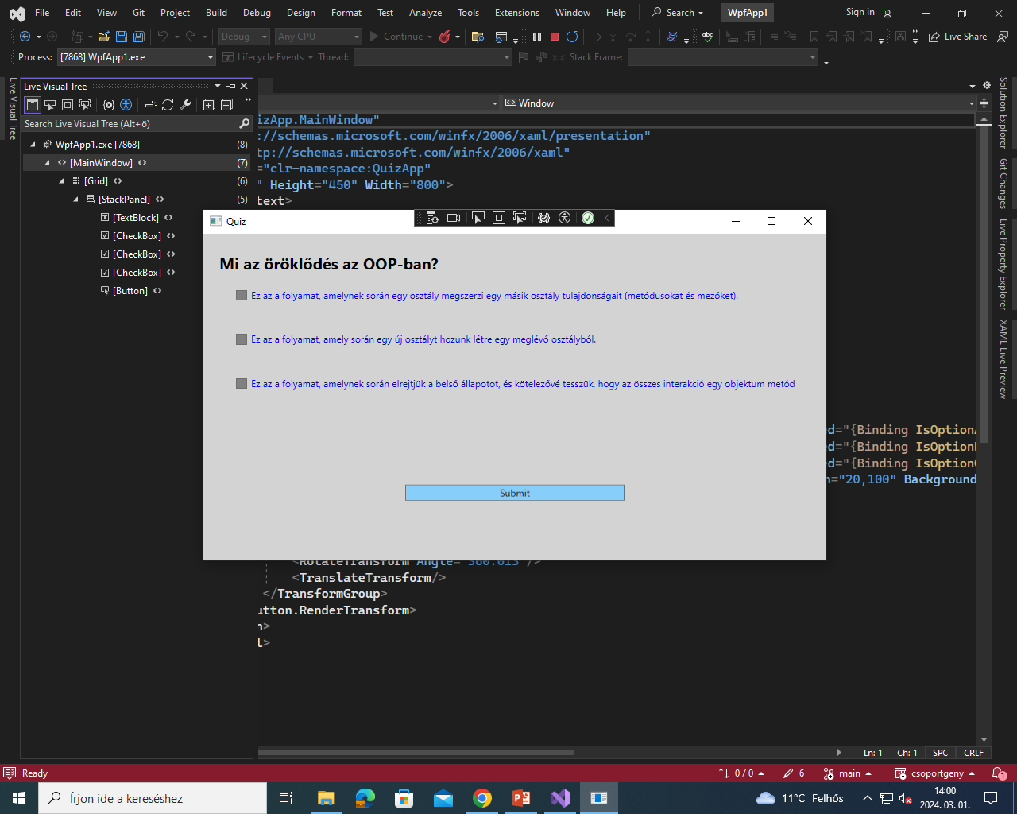
Introduction
name: QuizApp.
Purpose: measuring knowledge of ‚OOP’.

Slide 4
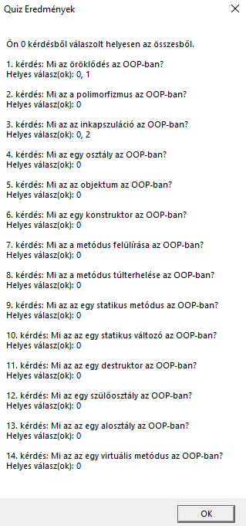
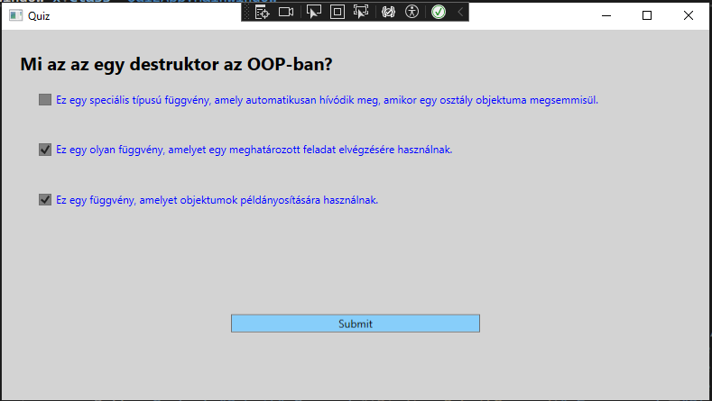
Features
Interactive quiz interface
Multiple-choice questions
Submission and feedback mechanism

Slide 5
How it Works - User Interface
The user interface consists of several components:
Question Text: The question is displayed. positioned at the top making it easy for users to read and understand.
Answer Options: Below the question text, users will find checkboxes representing the answer options.
Submit Button: At the bottom of the interface, there is a "Submit" button. Users can click this button after selecting their answers to submit their responses and receive feedback.

